Slide 1
Programming the Crowd

Slide 2
Algorithms for human computation
MTurk provides an on-demand source for human computation
Potential opportunities for exploring algorithms that use people as a function call
However, MTurk isn’t set up to support algorithms

Slide 3
MTurk limitations
MTurk requesters can post batches of independent jobs
Perfect for tasks that can be done in parallel like labeling 1000 images
But poorly suited for tasks that build on each other
What is MTurk missing that is essential in algorithms or programming languages?
Notes:
if then else example, for loops, while loops

Slide 4
TurKit: A programming language for the crowd
ideas = []
for (var i = 0; i < 5; i++) {
idea = mturk.prompt(
"What’s fun to see in New York City? Ideas so far: " + ideas.join(", "))
ideas.push(idea)
}
ideas.sort(function (a, b) {
v = mturk.vote("Which is better?", [a, b]) return v == a ? ‐1 : 1
})
Notes:
Generate a list of ideas on what to do in NYC and then sort them.
TurKit lets them use Mechanical Turk as a function call to generate ideas and compare them.

Slide 5
What new concerns exist for crowd programming?
After a HIT is posted to MTurk, it can take hours before Turkers complete it and so latency could cause algorithms to take days
What is the behavior if your program crashes?
What if this happens after you have already spent money on a bunch of HITs?

Slide 6
Crash and re-run
TurKit introduces a new programming paradigm called crash and rerun
Designed for long running processes where local computation is cheap, and remote work is costly
(Crash) Cache and re-run
Notes:
Page 46 of Greg’s thesis gives some examples of other programming languages which maintain states between runs

Slide 7
Quicksort
quicksort(A):
if A.length > 0:
pivot ← A.remove(A.randomIndex())
left ← new array; right ← new array
for x in A:
if compare(x, pivot):
left.add(x)
else:
right.add(x)
quicksort(left)
quicksort(right)
A.set(left + pivot + right)

Slide 8
81
39
68
9
3
28
62
42
25
97
Notes:
animation of quicksort
animate it once for an array of words, animate it a second time for an array of kittens
http://www.csanimated.com/animation.php?t=Quicksort
NOTE: The above link is deprecated as Adobe Flash is no longer supported; alternatively, here is another animation of Quicksort: http://cs.armstrong.edu/liang/animation/web/QuickSortPartition.html

Slide 9
81
39
68
9
3
28
62
42
25
97

Slide 10
81
39
68
9
3
28
62
25
97
42

Slide 11
39
68
9
3
28
62
25
97
81
>
42

Slide 12
39
68
9
3
28
62
25
97
42
81

Slide 13
68
9
3
28
62
25
97
39
<
42
81

Slide 14
68
9
3
28
62
25
97
42
39
81

Slide 15
9
3
28
62
25
97
68
>
42
39
81

Slide 16
9
3
28
62
25
97
42
39
81
68

Slide 17
3
28
62
25
97
9
<
42
39
81
68

Slide 18
3
28
62
25
97
42
39
9
81
68

Slide 19
28
62
25
97
3
<
42
39
9
81
68

Slide 20
62
25
97
28
<
42
39
9
3
81
68

Slide 21
25
97
62
>
42
39
9
3
28
81
68

Slide 22
97
25
<
42
39
9
3
28
81
68
62

Slide 23
97
>
42
39
9
3
28
25
81
68
62

Slide 24
42
39
9
3
28
25
81
68
62
97

Slide 25
39
9
3
28
25
42
81
68
62
97

Slide 26
39
9
3
28
25
42
81
68
62
97

Slide 27
39
9
3
25
42
81
62
97
28
68

Slide 28
9
3
25
42
62
97
39
81
>
>
28
68

Slide 29
3
25
42
97
9
62
<
<
28
68
39
81

Slide 30
25
42
3
97
<
>
28
68
9
39
62
81

Slide 31
42
25
<
28
68
9
3
39
62
81
97

Slide 32
42
28
68
9
3
25
39
62
81
97

Slide 33
9
3
25
28
39
42
62
68
81
97

Slide 34
9
3
25
28
39
42
62
68
81
97

Slide 35
9
3
25
28
39
42
62
68
81
97

Slide 36
3
25
28
39
42
62
68
97
9
81

Slide 37
25
28
39
42
62
68
3
97
<
>
9
81

Slide 38
25
28
39
42
62
68
9
81
3
97

Slide 39
28
39
42
62
68
25
>
9
81
3
97

Slide 40
28
39
42
62
68
9
81
3
25
97

Slide 41
3
9
25
28
39
42
62
68
81
97

Slide 42
3
9
25
28
39
42
62
68
81
97

Slide 43
Quicksort on MTurk
compare(a, b):
hitId ← createHIT(...a...b...)
result ← getHITResult(hitId)
return (result says a < b)

Slide 44
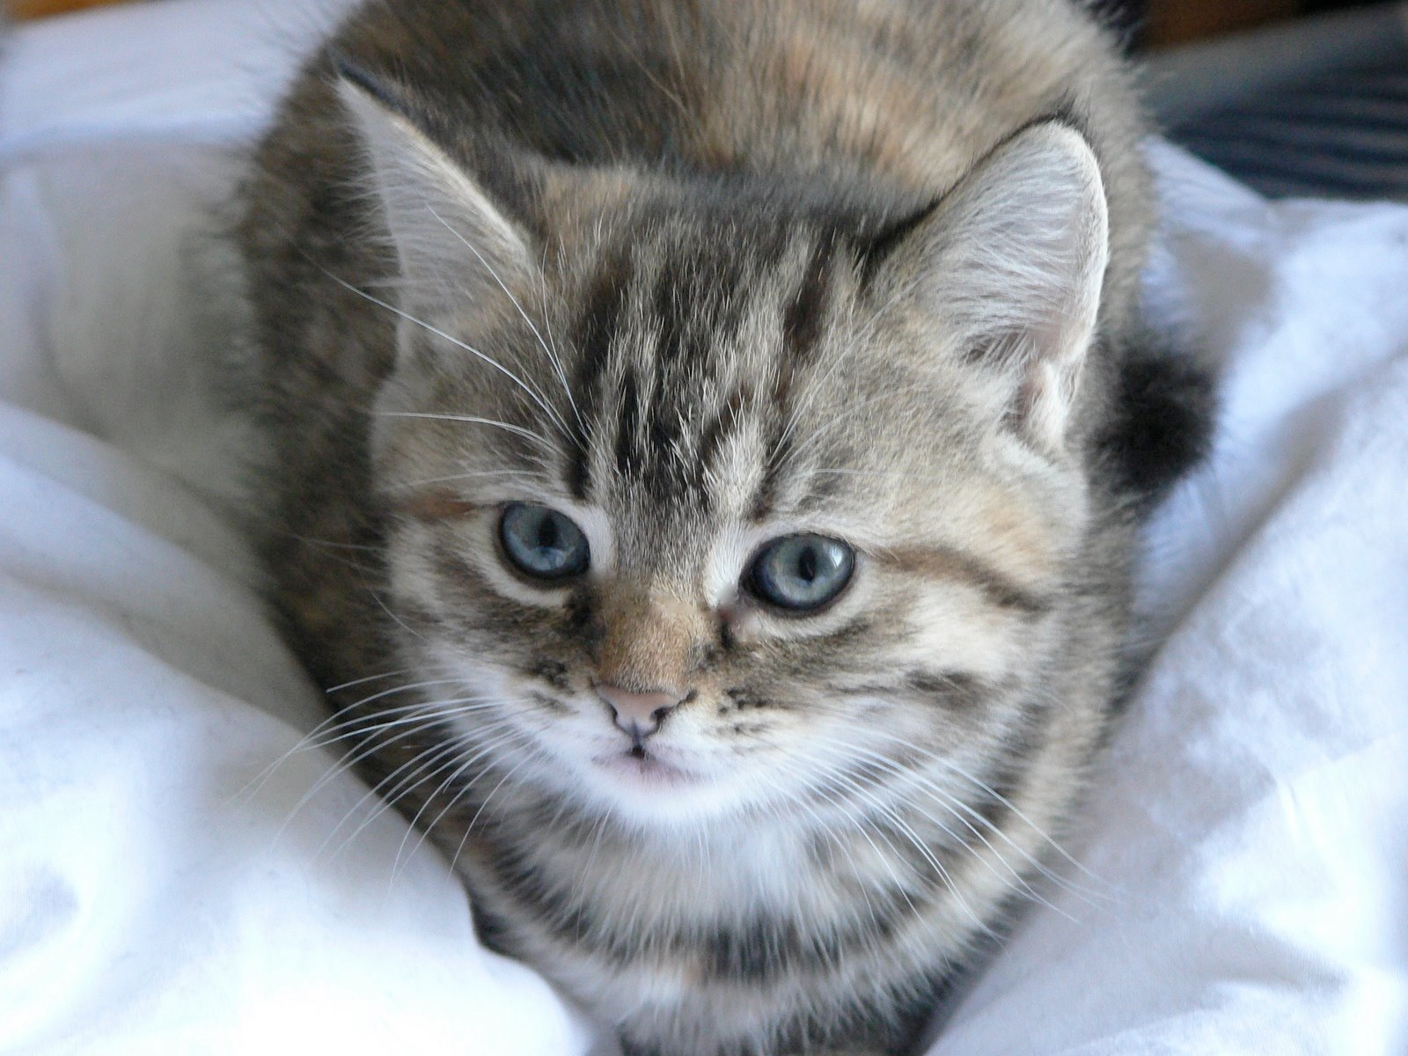
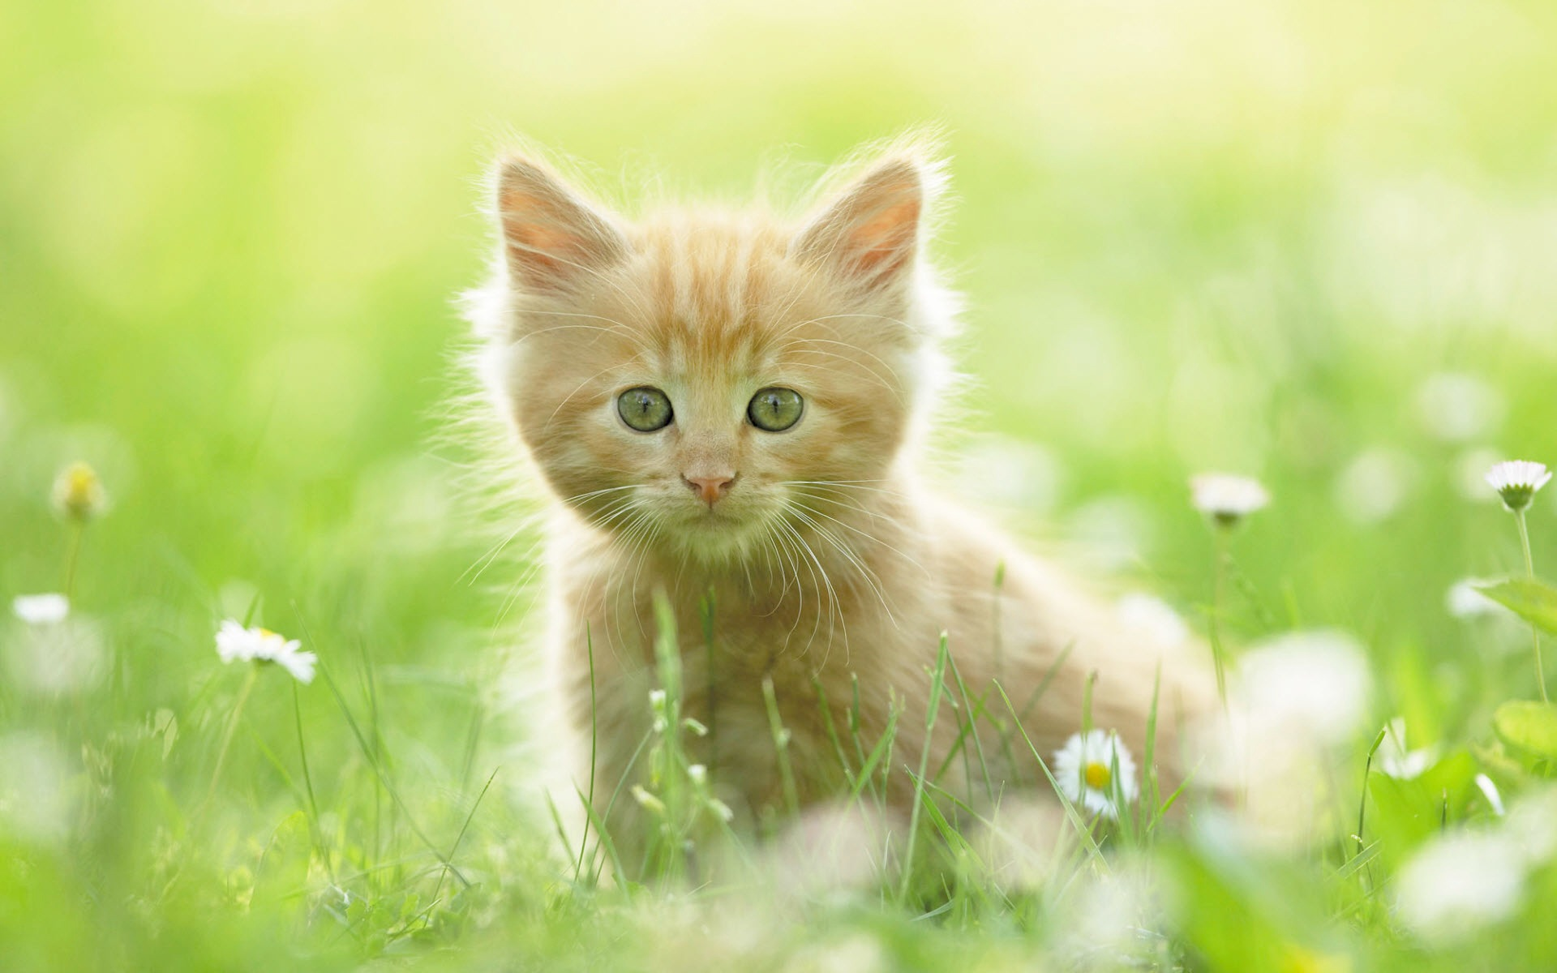

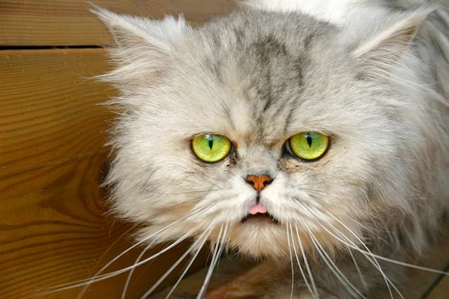
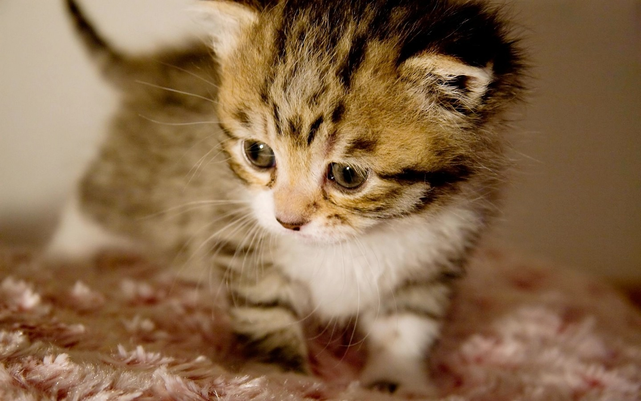
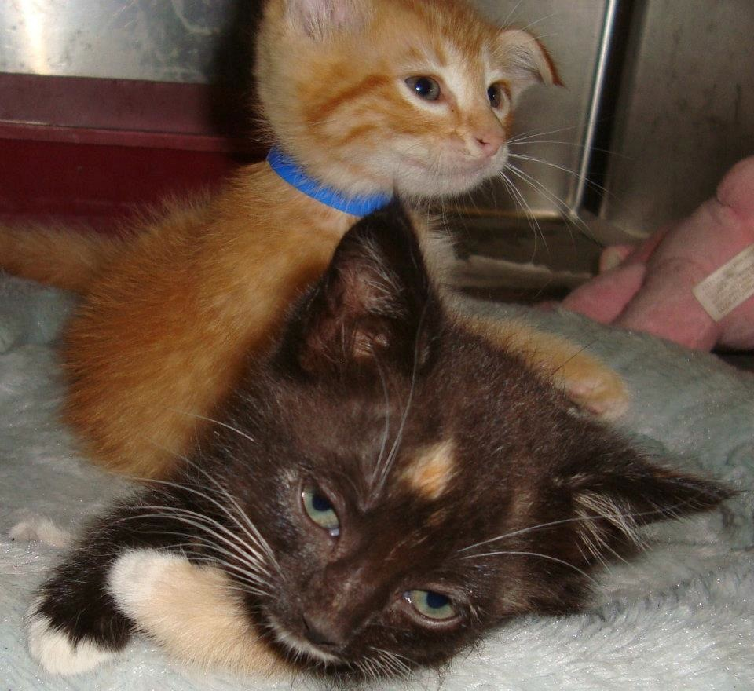
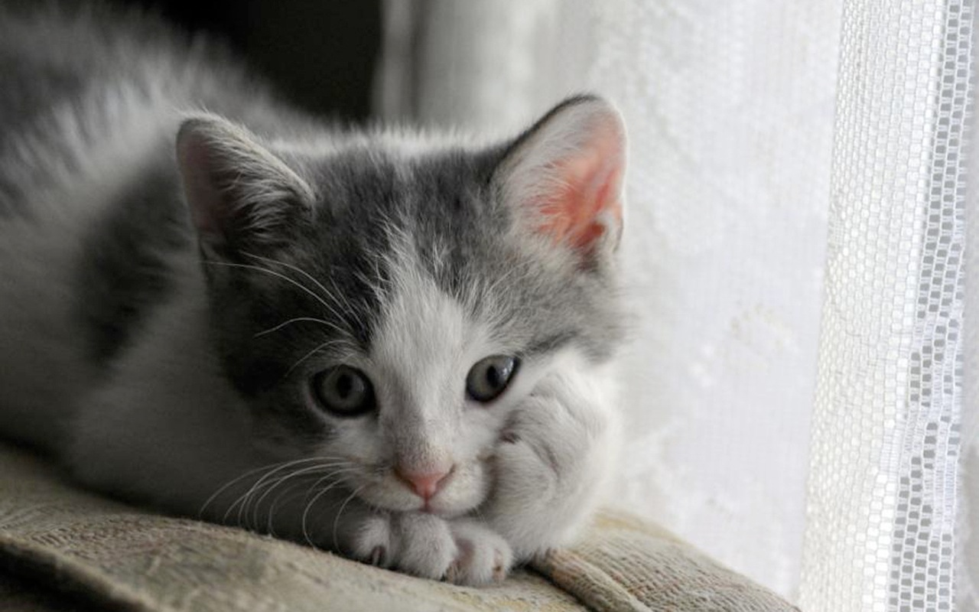

Slide 46
>

Slide 47
>

Slide 48
<

Slide 49
<

Slide 50
>

Slide 51
>

Slide 55
>
<

Slide 56
>

Slide 57
<

Slide 61
>

Slide 63
Quicksort as a long-running process
With this implementation we must wait for people to complete their judgments
The algorithm may need to run for a very long time while waiting
Challenge: How to maintain state

Slide 64
Quicksort as a long-running process
Normally quicksort maintains its state in the heap or the stack
These are normally dynamically allocated in memory, and used by all of the programs running on a computer
Memory isn’t typically used for hours or days
If the computer reboots, then our program’s state would be lost and we would lose $$$

Slide 65
Store results in a DB
Insight of crash-and-rerun paradigm is that if the program crashes, it should be cheap to re-run
Use a database to store all of the results up to the place that it crashed
Since local computation is cheap, calling DB and re-executing code with store results is cheap

Slide 66
New keyword once
Costly operations can be marked in a TurKit program with keyword once
once denotes that an operation should only be executed once across all runs of a program

Slide 67
Quicksort on MTurk
compare(a, b):
hitId ← once createHIT(...a...b...)
result ← once getHITResult(hitId)
return (result says a < b)
Subsequent runs of the program will check the database before performing these operations

Slide 68
When should you mark a function with once?
High cost: This is its main usage; whenever a function is high-cost in terms of money or time, once saves the day
Non-determinism: Storing results in DB assumes that the program executes in a deterministic way

Slide 70
Notes:
Originally we picked this picture at random to begin the comparison.

Slide 71
Notes:
But what if we next time, we instead randomly chose this one?

Slide 72
✓

Slide 73
✓
X
X
X
✓
X

Slide 74
X
X
X
✓
X
✓
X

Slide 75
Quicksort
quicksort(A):
if A.length > 0:
pivot ← A.remove(once A.randomIndex())
left ← new array; right ← new array
for x in A:
if compare(x, pivot):
left.add(x)
else:
right.add(x)
quicksort(left)
quicksort(right)
A.set(left + pivot + right)

Slide 76
When should you mark a function with once?
Side-effects: If a function has side effects during repeated calls, then wrap it in once
Notes:
For example, calling “Bonus” on MTurk multiple times would caused problems, or if calling Reject toggled the operation, then wrap with once.

Slide 77
Other benefits of once
Incremental programming: You can write part of an algorithm, test it, view the results, modify it, and rerun.
Retroactive print-line debugging: If your program behaves in an unexpected fashion, you can put in debugging print statements after the fact
This also lets you print data to a file if you decide that you want to analyze it
Notes:
As long as you haven’t modified the order of important operations, then once will save you money with incremental programming
Retroactive print-line debugging will execute quickly, because of the cached results

Slide 78
TurKit script
TurKit is built on top of JavaScript
Users have full access to JavaScript
Plus a set of APIs built around MTurk and the crash-and-rerun programming paradigm

Slide 79
TurKit keywords
once
crash
fork / join

Slide 80
The crash keyword
Why in the hell would you want to tell your program to crash?
Since we cache results in a DB, crash is an alternate to wait
Most common use for crash is waiting for results to be returned from MTurk
TurKit automatically re-runs program after a set interval

Slide 81
fork allows for parallel execution
TurKit allows multiple branches to be run in parallel via fork
Calling crash from within a forked branch resumes the execution of the former branch
This allows you to post multiple jobs on MTurk simultaneously
The script can make progress on whatever path gets a result first

Slide 82
One HIT at a time
a = createHITAndWait() // HIT A
b = createHITAndWait(...a...) // HIT B
c = createHITAndWait() // HIT C
d = createHITAndWait(...c...) // HIT D
B depends on A
D depends on C
They don’t depend on each other. Why wait?

Slide 83
Multiple HITs at a time
fork(function() {
a = createHITAndWait() // HIT A
b = createHITAndWait(...a...) // HIT B
})
fork(function() {
c = createHITAndWait() // HIT C
d = createHITAndWait(...c...) // HIT D
})
Notes:
The first time around, TurKit would get to the first fork, create HIT A, and try to wait for it.
It would not be done, so it would crash that forked branch (rather than actually waiting),
And then the next fork would create HIT C.
So the first time the script runs, HITs A and C will be created, and each subsequent time it runs, it will check on both HITs to see if they are done.

Slide 84
The join keyword
fork(...b = ...)
fork(...d = ...)
join()
e = createHITAndWait(...b...d...)
join waits for all previous forks for finish

Slide 85
Calling Mechanical Turk
TurKit adds several simple commands for interacting with MTurk:
prompt
vote
sort

Slide 86
Calling MTurk: prompt
print(mturk.prompt(“When did Colorado become a state?”))
prompt optionally allows a second argument with the number of responses
a = mturk.prompt(“What is your favorite color?”, 100)

Slide 87
Calling MTurk: vote
v = mturk.vote("Which is better?", [a, b])
// returns the list item with the most votes
Optional 3rd argument to specify how many votes to collect

Slide 88
Calling MTurk: vote
function vote(message, options) {
// create comparison HIT
var h = mturk.createHITAndWait({
...message...options...
assignments : 3})
// get enough votes
while (...votes for best option < 3...) {
mturk.extendHIT(...add assignment...)
h = mturk.waitForHIT(h)
}
return ...best option...
}
Notes:
More sophisticated voting that doesn’t collect all votes if first ones are for majority.

Slide 89
Calling MTurk: sort
ideas.sort(function (a, b) {
v = mturk.vote("Which is better?", [a, b])
return v == a ? ‐1 : 1
})
This version just uses JavaScript’s built-in sorting function
Defines a comparator using mturk.vote
Negative: Comparisons are done serially
Notes:
The paper on the syllabus defines a way of doing quick sort in parallel using the fork() command

Slide 90
Under the hood
TurKit is handles the MTurk API
It generates web pages and CSS and hosts them on Amazon’s S3 server
Nice additional features, like disabling of form elements while in preview mode
DB is serialized using JSON

Slide 91
TurKit
IDE for writing TurKit scripts, running them, and automatically rerunning them
TurKit “crashes” after publishing a HIT; re-running polls MTurk to check for result
Provides controls for switching from sandbox into normal MTurk, clearing DB

Slide 92
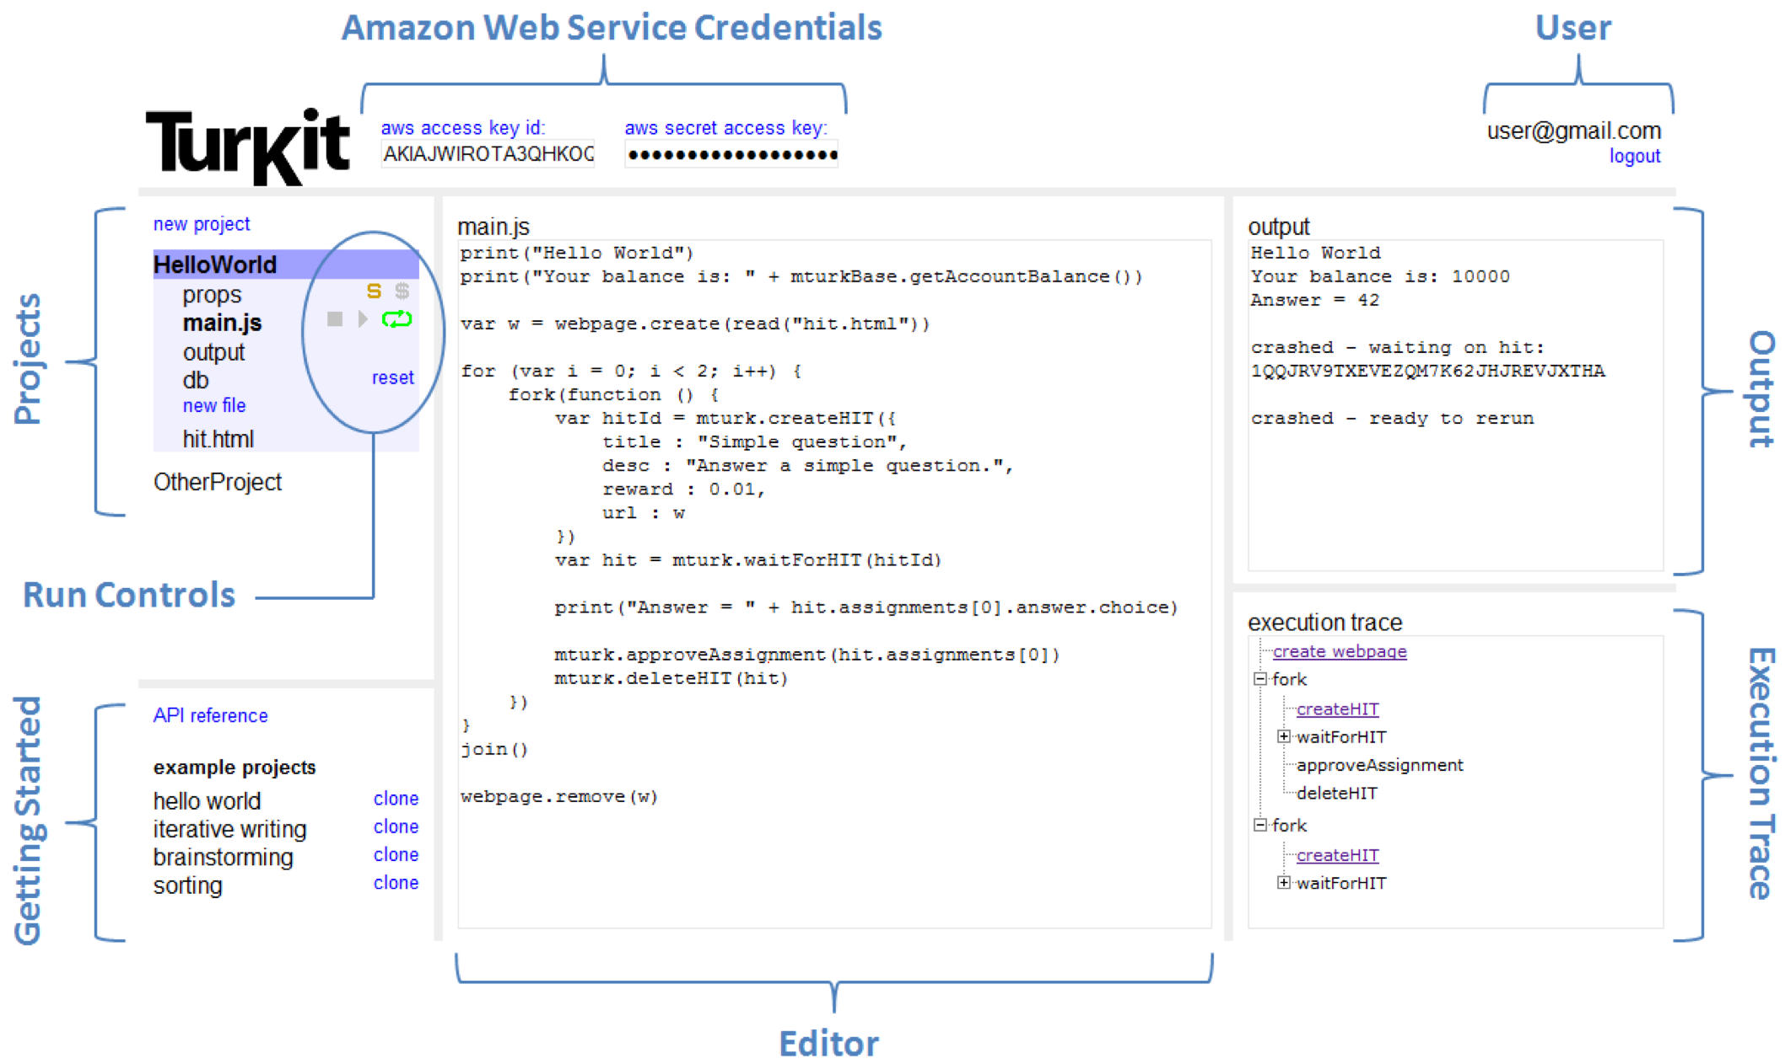
Notes:
ccb - todo - update this with screenshots

Slide 93
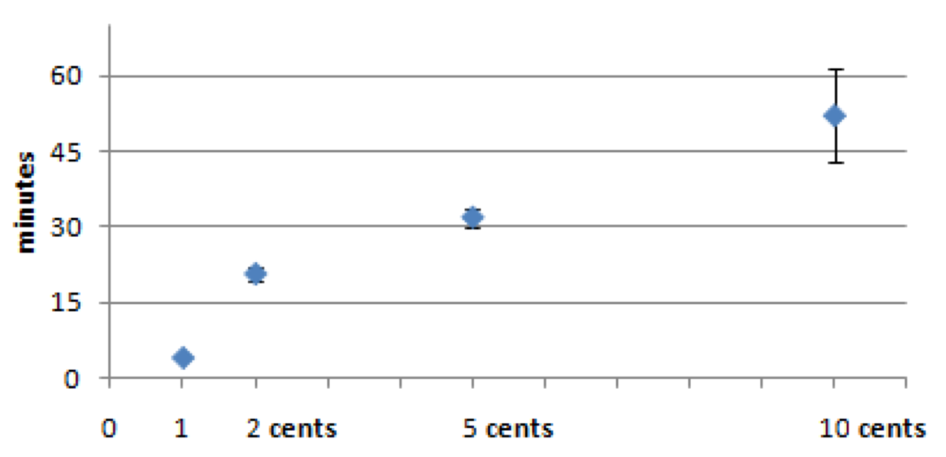
Time for results to come back, by reward amount
Notes:
Analyzed results over 30,000 assignments. Time took longer for higher paying tasks. Why? Higher paying tasks might contain more work, and therefore are longer. Even subtracting work time out, the time until take-up followed the same trend. Why?
Our higher paying tasks are typically more difficult, so we expect them to take longer to perform. However, if we subtract this time, the chart still increases, meaning it takes longer for turkers to start the higher paying tasks. One explanation is that turkers sort by reward, and 10-cent tasks are not on the first page of results. Another explanation is that turkers are looking for quick and easy tasks.

Slide 94
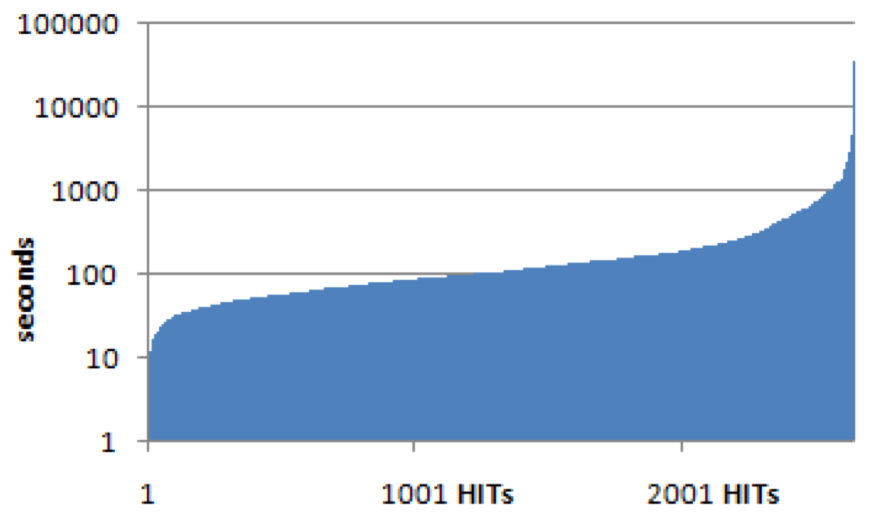
Time for first $0.01 assignment to complete
Notes:
Graph based on 2648 HITs with 1 cent reward. Only five completed within 10 seconds.
This gives a better picture of the round-trip time-to-completion for the 1-cent tasks. The average is 4 minutes, where 82% take between 30 seconds and 5 minutes. About 0.1% complete within 10 seconds. The fastest is 7 seconds.
Note log scale on y axis

Slide 95

Dealing with latency
Build the programming language to deal with high-latency operations
Do something to optimize throughput on MTurk
One (nefarious) example: Artificially inflate number of assignments in your HIT to get front-page placement
Notes:
ccb - todo - summarize Greg’s paper on SEO for MTurk

Slide 96
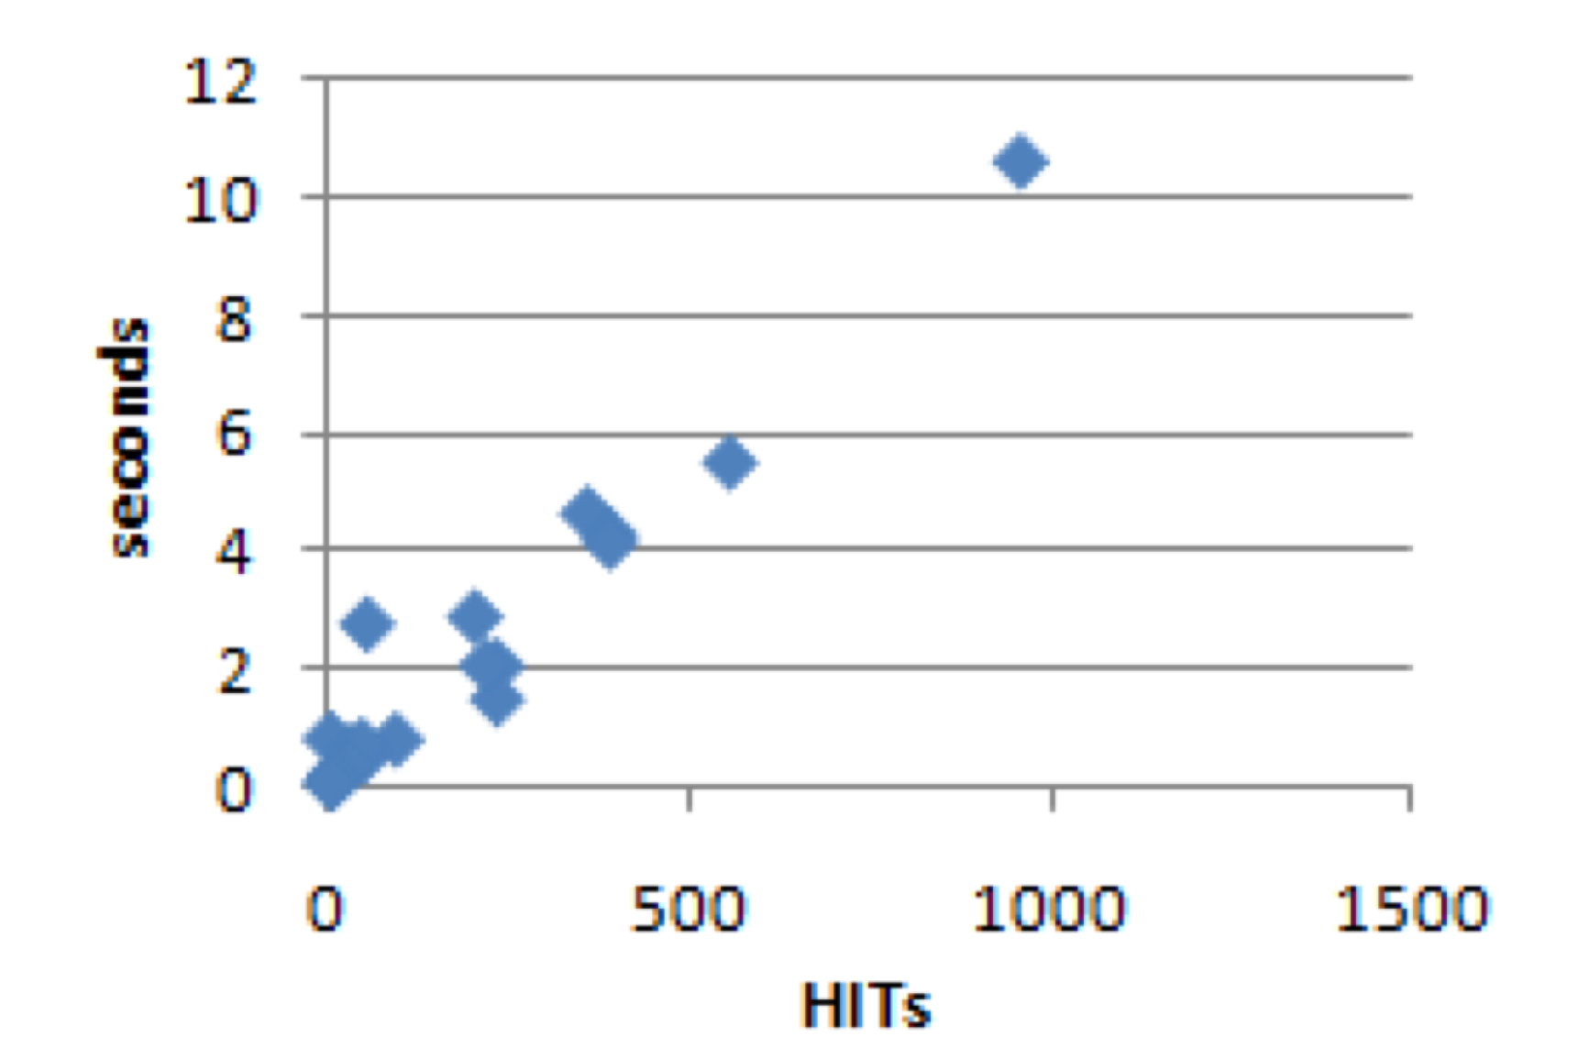
Time to execute once all HITs have been cached
Notes:
The largest script in our corpus creates 956 HITs. It takes 10.6 seconds to rerun a full trace, and the database file is 7.1MBs. It takes Rhino 0.91 seconds to parse and load the database into memory, where the database expands to 25.8MBs.

Slide 97
Pros and cons of TurKit
Con: Scalability – assumes local computation is minimal. Rerunning after each HIT might be tedious if task is large
Con: Parallel programming – not completely general in TurKit. once, fork and join do not give enough state.
Pro: Experimental replicability – usually one downside of human computation is that results with differ each time. Not so with TurKit!
Notes:
Parallel programming in the crash-and-rerun model is not completely general. For instance, we proposed a parallel version of quicksort that performs the partition in parallel, and then sorts each sublist in parallel. However, it joins between partitioning the elements, and sorting the sublists. In theory, this is not necessary. Once we have a few elements for a given sublist, we should be able to start sorting it right away (provided that we chose a pivot from among the elements that we have so far). Doing so is possible in TurKit by storing extra state information in the database, but is infeasible using once, fork and join alone.

Slide 98
What experiments would you run?

Slide 99
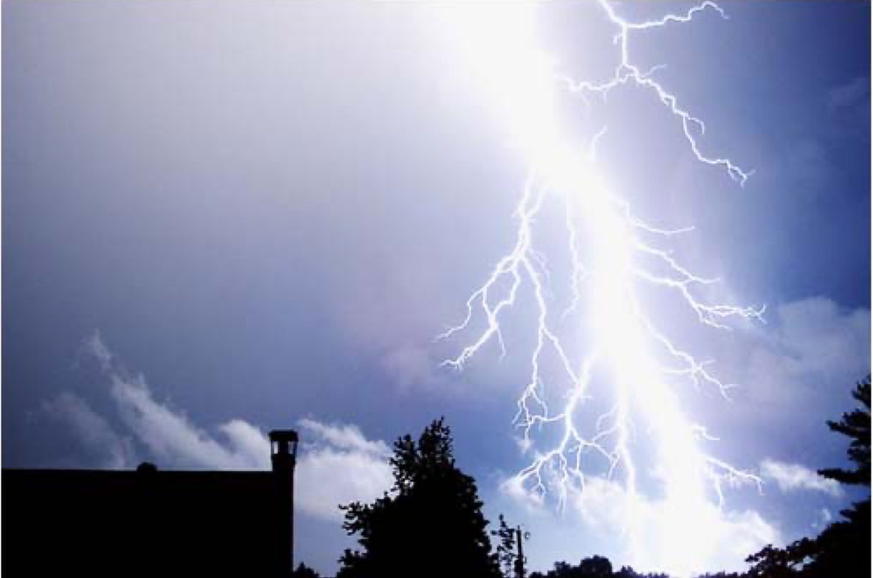
Next time…
Please describe the text factually
(You may use the provided text as a starting point, or delete it and start over)
Use no more than 500 characters
Lightening strike in a blue sky near a tree and a building.

Slide 100
Experiments with TurKit

Slide 101
Brainstorming
Our company sells headphones. There are many types and styles available. They are useful in different circumstances. Our site helps users assess their needs and get the pair of headphones that is right for them.
Please suggest 5 new company names for this company.
Notes:
First play video by Hanna and Mythili
First everyone should create 5 names on their own.
Draw a line underneath.
Next pass the paper to your right. Read what the other person wrote. Create 5 more ideas.
Draw a line underneath.
Next, discuss the ideas at your table. Create your 5 best ideas.

Slide 102
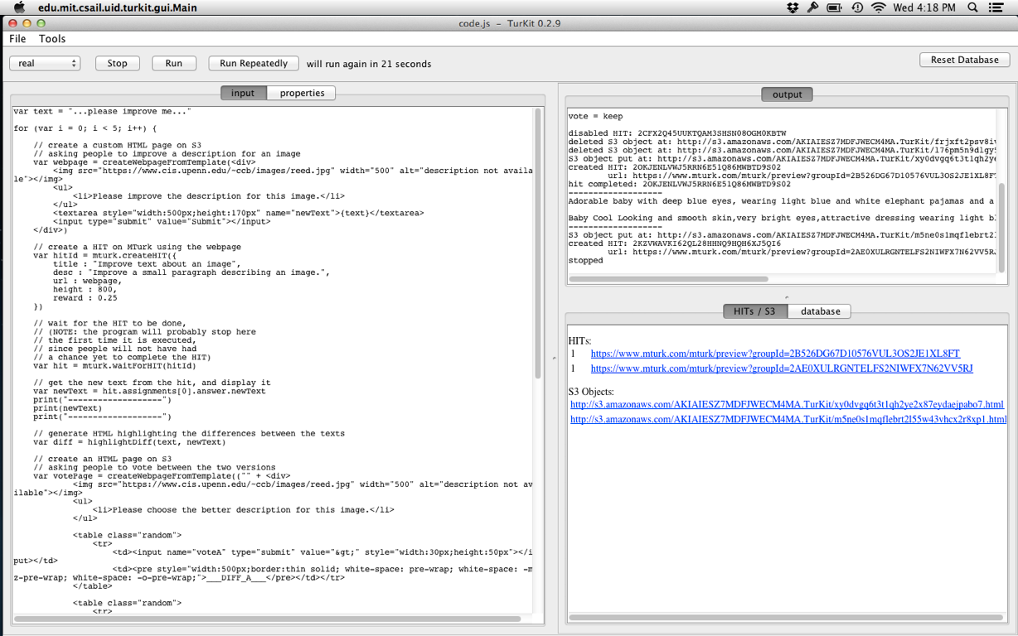
TurKit in action
Notes:
ccb - todo - show off example of TurKit running

Slide 103
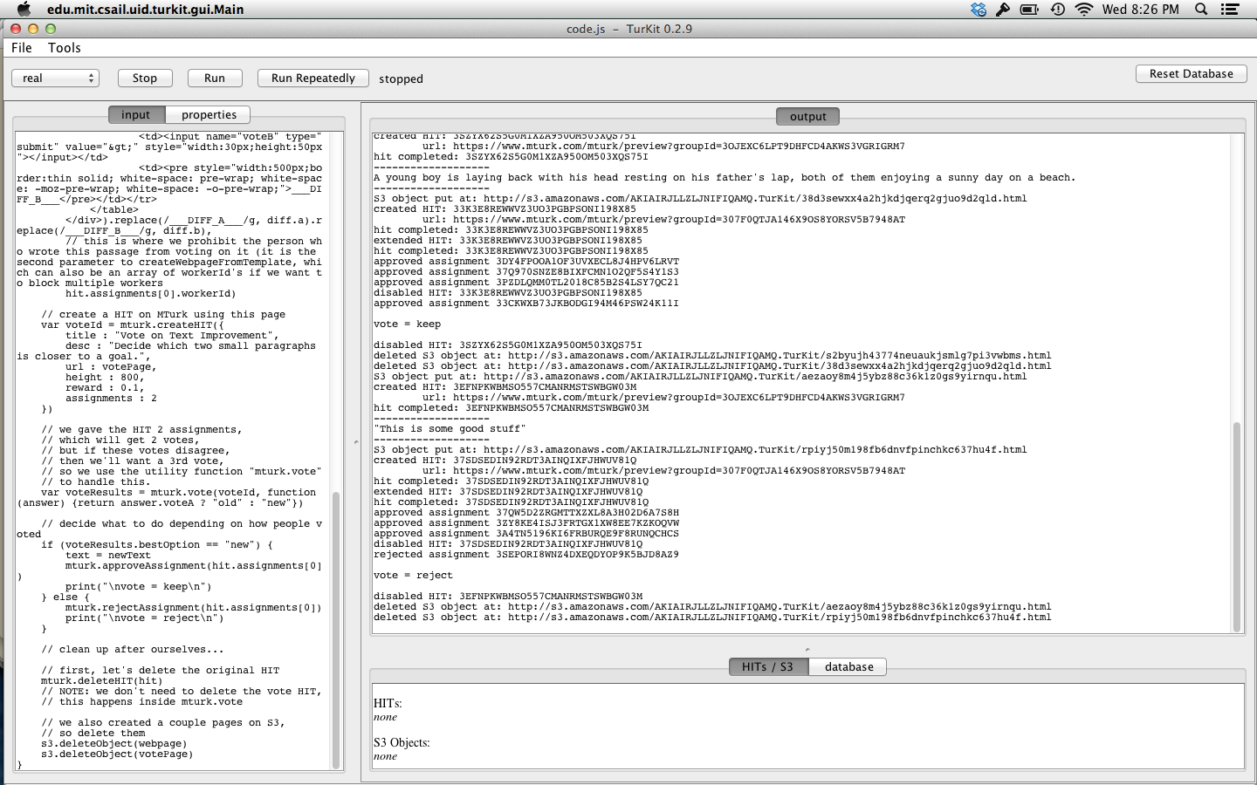
TurKit in action
Notes:
ccb - todo - show off example of TurKit running

Slide 104
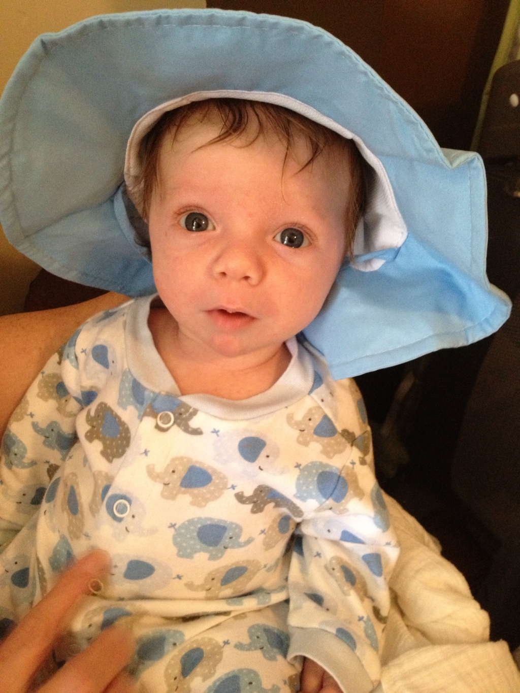
Adorable baby with deep blue eyes, wearing light blue and white elephant pajamas and a floppy blue hat.
Baby Cool Looking and smooth skin,very bright eyes,attractive dressing wearing light blue and white elephant pajamas and a floppy blue hat.Overall impression very sweet and also funny.

Slide 105
Father and son on a sandy beach.
Super cute kid lounges on a sandy beach with his father.
A father caught in a moment of ease with his young son, enjoying the natural vibes of the water and sand on a sunny day at the beach.
A young boy is laying back with his head resting on his father's lap, both of them enjoying a sunny day on a beach.
This is some good weed

Slide 106
What are the basic units of collecting work?
Human computation is a new field
Writing algorithms that involve people as function calls is relatively unexplored
How can we characterize the types of work that we can do, or the processes that yield the best results?

Slide 107
Iterative vs Parallel Processing
Basic distinction in the workflow
Should crowd workers do tasks independently in parallel?
Or should they work together in an iterative fashion and build off of each others’ work?

Slide 108
Tradeoffs
Iterative process shows each worker the results from previous workers
Must collect contributions serially
Parallel process asks each worker to solve a problem alone
No workers depend on the results of other workers, and so can be parallelized

Slide 109
Wikipedia vs Threadless
Iterative process: One person starts an article, and then other people iteratively improve it by looking at what people did before them and adding information, correcting grammar, creating a consistent style, etc.
Parallel process: T-shirts are created in parallel. People submit ideas independently, and then others vote to determine the best ideas that will be printed.

Slide 110

Wisdom of crowds
Requirements for a crowds to be wise:
Diversity of opinion
Independence
Decentralization
Aggregation

Slide 111
Wisdom of crowds: Independence
Surowiecki argues that aggregating answers from a decentralized, disorganized group of people all thinking independently yields more accurate answers than from individuals
Individual errors need to be uniformly distributed, and so individual judgments must be made independently

Slide 112
Does this hold empirically on MTurk?
Greg Little, Lydia Chilton, Max Goldman, and Rob Miller verify it through a set of experiments
Exploring tradeoffs between iterative vs parallel processing in writing, transcription, and brainstorming

Slide 113
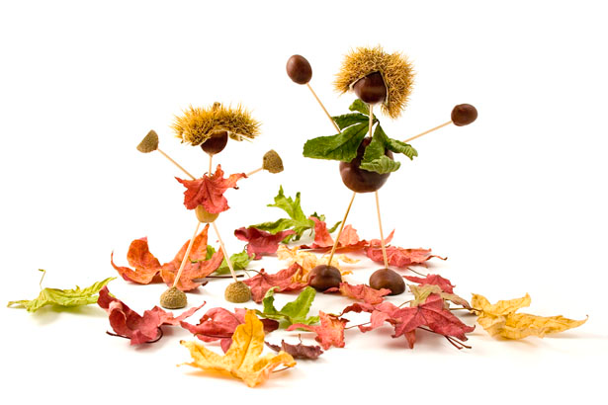
Writing
Notes:
This image shows an art project of people made out of nuts. They look like they are dancing in autumn leaves.
Creative mind must to do the art.
Male and female nuts are dancing with leaves flowers.
They are super match.

Slide 114
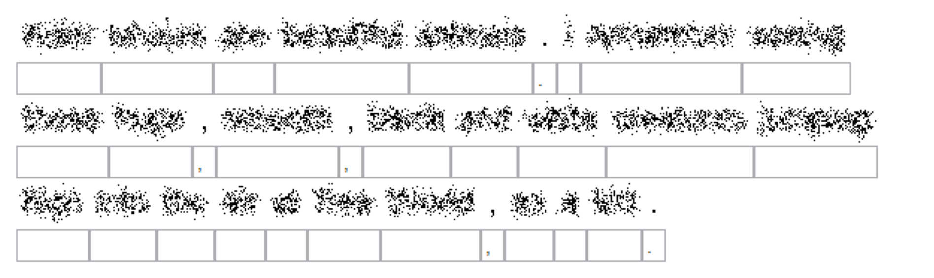
Transcription

Slide 115
Brainstorming
Our company sells headphones. There are many types and styles available. They are useful in different circumstances. Our site helps users assess their needs and get the pair of headphones that is right for them.
Please suggest 5 new company names for this company.

Slide 116
Higher level goals
Establish models and design patterns for human computation processes
Figure out how best to coordinate small contributions from many people to achieve a larger goal
Focus is on aggregation dimension from taxonomy of human computation

Slide 117
Model
 | dependently (iteratively) | independently (in parallel)
creation tasks
decision tasks
Notes:
Task type and how it is done

Slide 118

Creation tasks
Goal is to produce new high quality content
Example creation tasks: writing, ideas, imagery, solutions
Few constraints on worker inputs to the system
Computer doesn't understand workers’ input

Slide 119
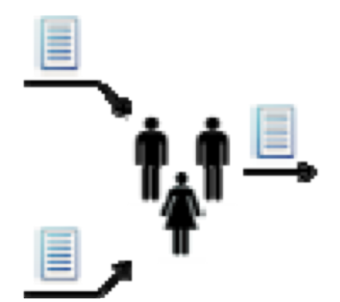
Decision tasks
Decision tasks solicit opinions about existing content
Example: choose between two descriptions of the same image
User input is constrained because the computer has to interpret the responses

Slide 120
Decision tasks
Goal of decision tasks is to solicit accurate responses
Solicit multiple responses and aggregate them
Mechanisms:
Comparisons: Is image description A better than image description B?
Ratings: Rate the quality of this description on a scale from 1-10.

Slide 121
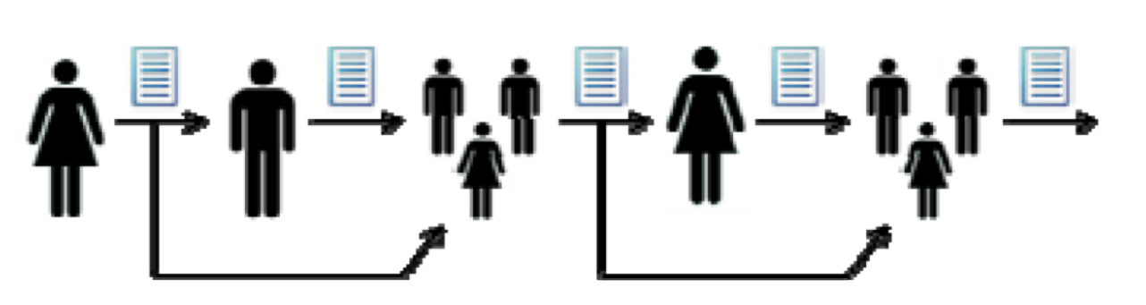
Pattern #1: Iterative combination
Workers are shown the content generated by previous workers
Computer optionally tracks the best content and either shows it or shows all previous content
Notes:
ccb - todo animate this figure

Slide 122
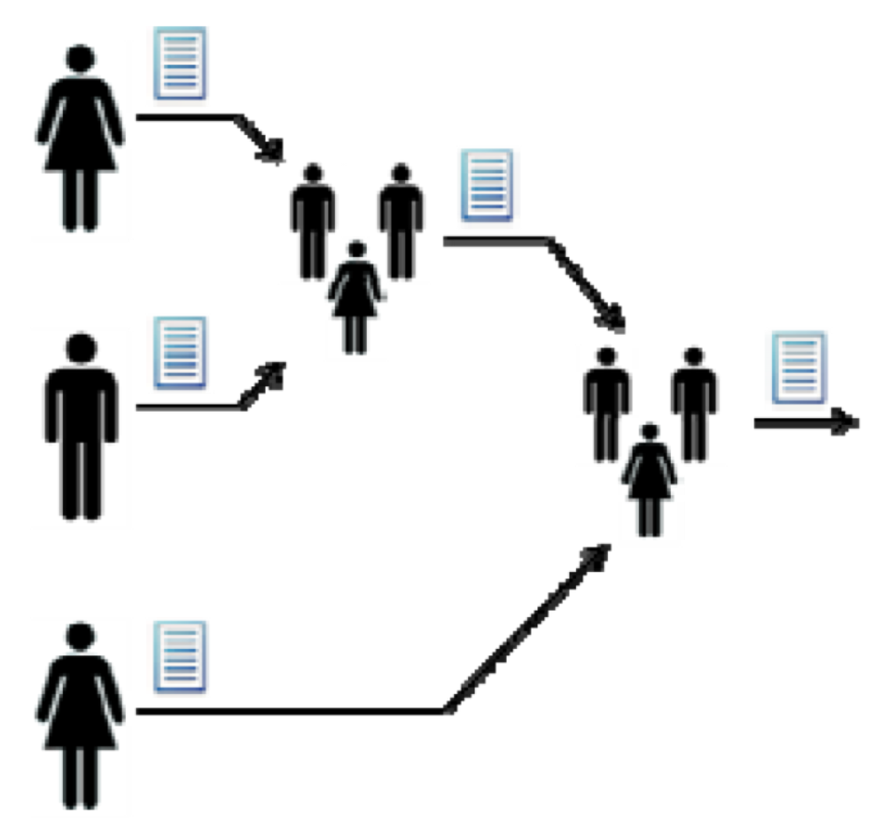
Pattern #2: Parallel creation
Creation tasks are executed in parallel
Workers do not see each others’ outputs
Outputs can be compared via decision tasks, as before
May be difficult to merge content

Slide 123
Experiments
Little, Chilton, Goldman, and Miller performed 3 experiments on MTurk to compare iterative vs parallel patterns:
1) Writing image descriptions
2) Brainstorming company names
3) Transcribing obscured texts

Slide 124
Experiment 1: Image description
Selected 30 engaging images from http://www.publicdomainpictures.net
Each image went through 6 creation tasks and 5 comparison tasks (with 5 people voting on the comparisons)
Ran on MTurk. Paid $0.02 for creation and $0.01 for comparison.

Slide 125
Please describe the text factually
(You may use the provided text as a starting point, or delete it and start over)
Use no more than 500 characters
Lightening strike in a blue sky near a tree and a building.

Slide 126
Iteration 1: Lightening strike in a blue sky near a tree and a building.
Iteration 2: The image depicts a strike of fork lightening, striking ablue sky over a silhoutted building and trees. (4/5 votes)
Iteration 3: The image depicts a strike of fork lightning, against a blue sky with a few white clouds over a silhouetted building and trees. (5/5 votes)
Iteration 4: The image depicts a strike of fork lightning, against a blue sky- wonderful capture of the nature. (1/5 votes)
Iteration 5: This image shows a large white strike of lightning coming down from a blue sky with the tops of the trees and rooftop peaking from the bottom. (3/5 votes)
Iteration 6: This image shows a large white strike of lightning coming down from a blue sky with the silhouettes of tops of the trees and rooftop peeking from the bottom. The sky is a dark blue and the lightening is a contrasting bright white. The lightening has many arms of electricity coming off of it. (4/5 votes)
Notes:
CCB - possibly show the iterative pipeline again

Slide 127
This image shows a large white strike of lightning coming down from a blue sky with the silhouettes of tops of the trees and rooftop peeking from the bottom. The sky is a dark blue and the lightening is a contrasting bright white. The lightening has many arms of electricity coming off of it.
Average Rating: 8.7
White lightning n a root-like formation shown against a slightly wispy clouded, blue sky, flashing from top to bottom. Bottom fifth of image shows silhouette of trees and a building.
Average Rating: 7.2
Notes:
Turkers were shown an image and a description, and asked to rate the quality of the description as a factual description of the image, on a scale of 1 to 10. We obtained 10 ratings for each image description to compute an average rating.
Averaged over all 30 images the Iterative wins at 7.9 versus 7.4. This is significant at p=0.004.

Slide 128
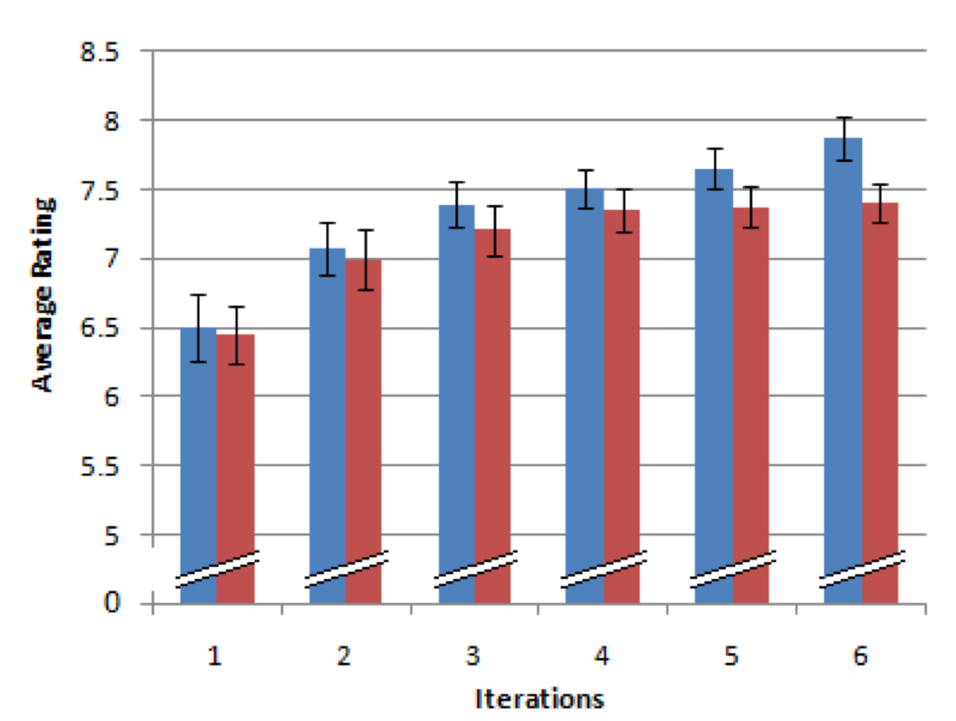
Relative improvements after each iteration
Iterative
Parallel
Notes:
Iteration 1 - they are the same, as you would expect.
The diverge as we increate the number of iterations.
Why?

Slide 129
What do Workers do at each iteration?
31% mainly append content at the end, make only minor modifications (if any) to existing content
27% modify/expand existing content, but it is evident that they use the provided description as a basis
17% seem to ignore the provided description entirely and start over
13% mostly trim or remove content
11% make very small changes (adding a word, fixing a misspelling)
Notes:
1% copy-paste random content from the internet

Slide 130
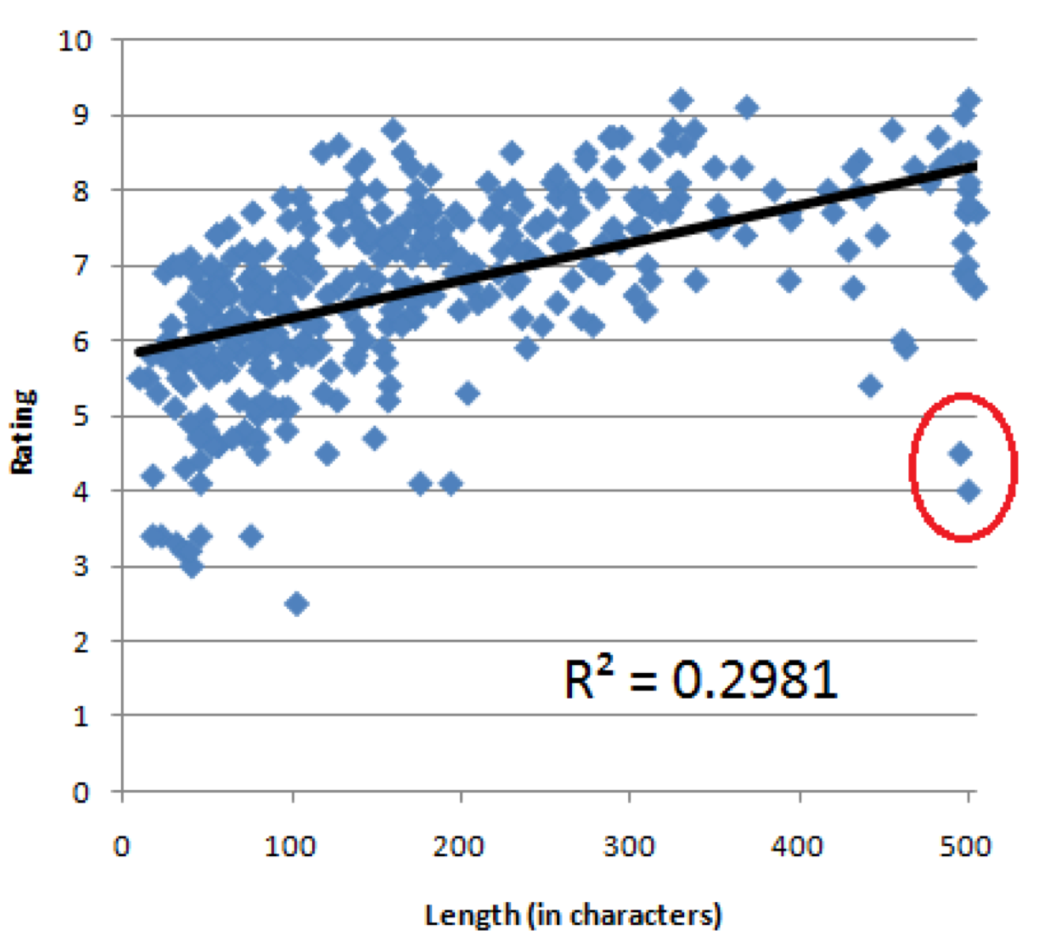
Correlation with description length and rating
Notes:
Figure 4: Descriptions are plotted according to their length
and rating. A linear regression shows a positive correlation (R2 = 0.2981, N = 360, 􏰃 = 0.005, p < 0.0001). The two circled outliers represent instances of text copied from the internet.

Slide 131
Experiment 2: Brainstorming names
Presented descriptions of 6 fictional companies
Asked Turkers to list 5 names each
Iteration had 6 tasks for each company, Turkers are shown the names so far
Parallel had 6 independent Turkers for each company

Slide 132
Brainstorming
Our company sells headphones. There are many types and styles available. They are useful in different circumstances. Our site helps users assess their needs, and get the pair of headphones that is right for them.
Please suggest 5 new company names for this company.

Slide 133
Example names
Iterative |  | Parallel
Easy on the Ears | 7.3 | music brain | 8.3
Easy Listening | 7.1 | Headphone House | 7.4
Music Explorer | 7.1 | Headshop | 7
Right Choice Headphone | 7.1 | Talkie | 6.8
... |  | ...
Least noisy hearer | 5.1 | company sell | 4.3
Headphony | 4.9 | head phones r us | 4.2
Shop Headphone | 4.8 | different circumstances | 3.7
Notes:
There are no bad ideas in brainstorming, but company sell and different circumstances are genuinely pretty terrible.
The best rated name generated in the iterative process is rated 7.3, compared with 8.3 for the parallel process. In fact, the parallel process generated the best rated name for 4 out of the 6 fake companies.

Slide 134
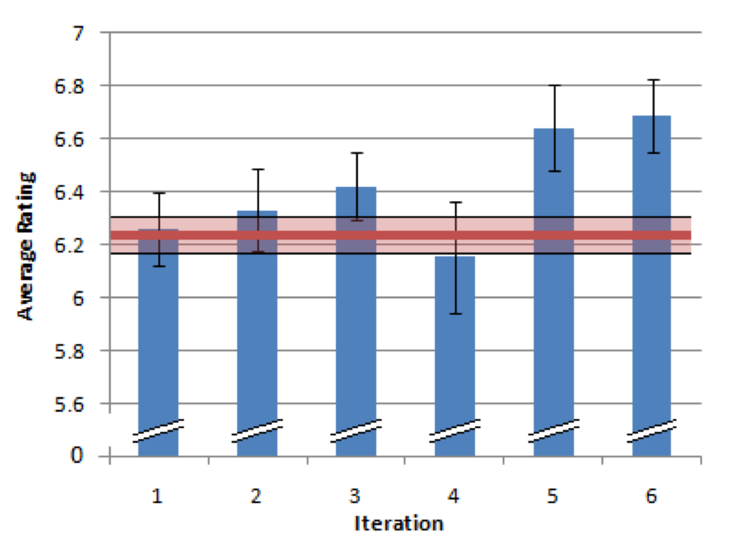
Iterative improvements
Iterative
Avg parallel
Notes:
The average name generated in the iterative process is rated higher (6.4 vs. 6.2).
Iteration four breaks the pattern, but this appears to be a coincidence. Three of the contributions in this iteration were considerably below average. Two of these contributions were made by the same turker (for different companies). A number of their suggestions appear to have been marked down for being grammatically awkward: “How to Work Computer”, and “Shop Headphone”. The other turker suggested names that could be considered offensive: “the galloping coed” and “stick a fork in me”.

Slide 135
Getting the best name
Iteration seems to increase the average rating of new names
Not clear that iteration is the right choice for generating the best rated names
Iterative process has a lower variance: 0.68 compared with 0.9 for the parallel process
Showing Turkers suggestions may cause them to riff on the best ideas they see, but makes them unlikely to think too far afield from those ideas
Notes:
Does showing people name suggestions inhibit their ability to generate the very best new name ideas?
If so, is there anything we can do in an iterative process that will help generate the best names?
Alternatively, is there any way we can increase the variance in the parallel process, to have an even better chance of generating the best names?

Slide 136
Experiment 3: Blurry text recognition
Human OCR, inspired by reCAPTCHA
“We considered other puzzle possibilities, but were concerned that they might be too fun”
16 creation task in both iterative and parallel processing

Slide 137
Blurry text transcription
Notes:
The instructions are simply to transcribe as many words as possible, and add a ‘*’ in front of words that they are unsure about.
We composed twelve original passages, so turkers couldn’t find the text on the web by searching with some of the keywords they had deciphered.
“blur” tool from some popular image editing program

Slide 138
Choosing the best result
If a particular word is guessed a plurality of times, then choose it
Otherwise pick at random from the words that tied for best

Slide 139
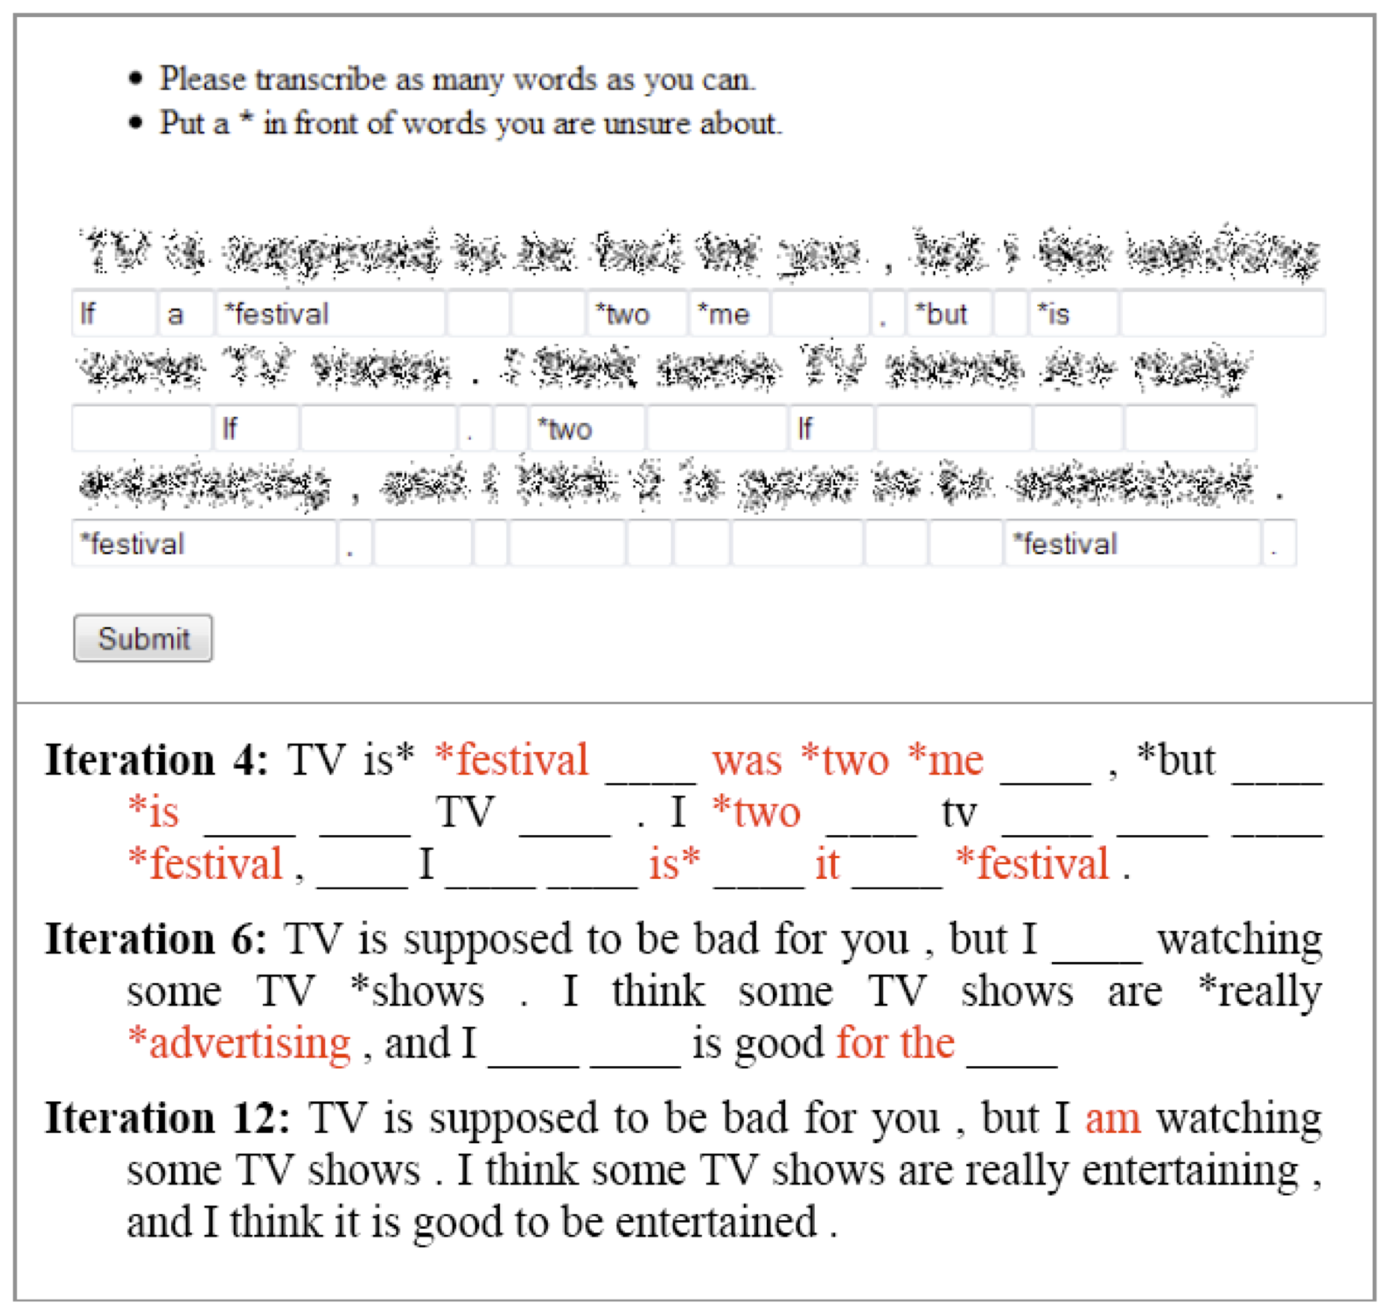

Slide 140
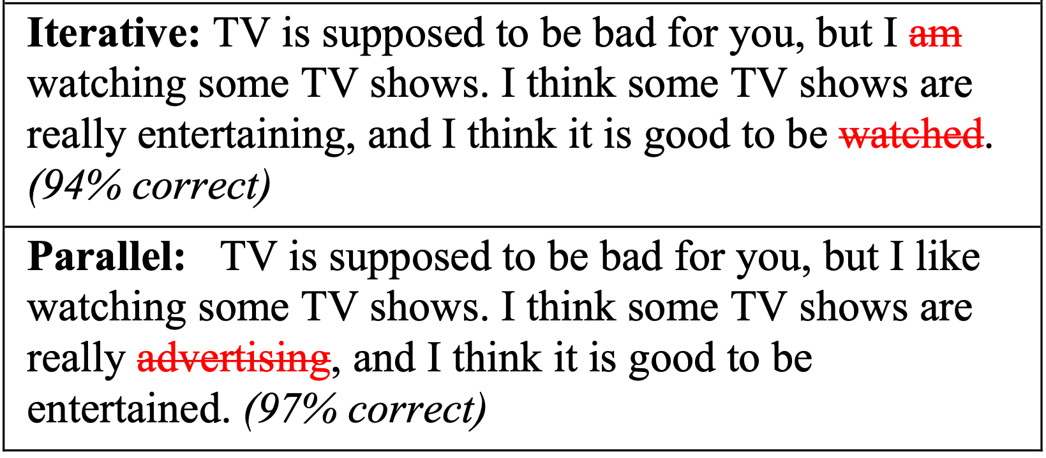

Slide 141
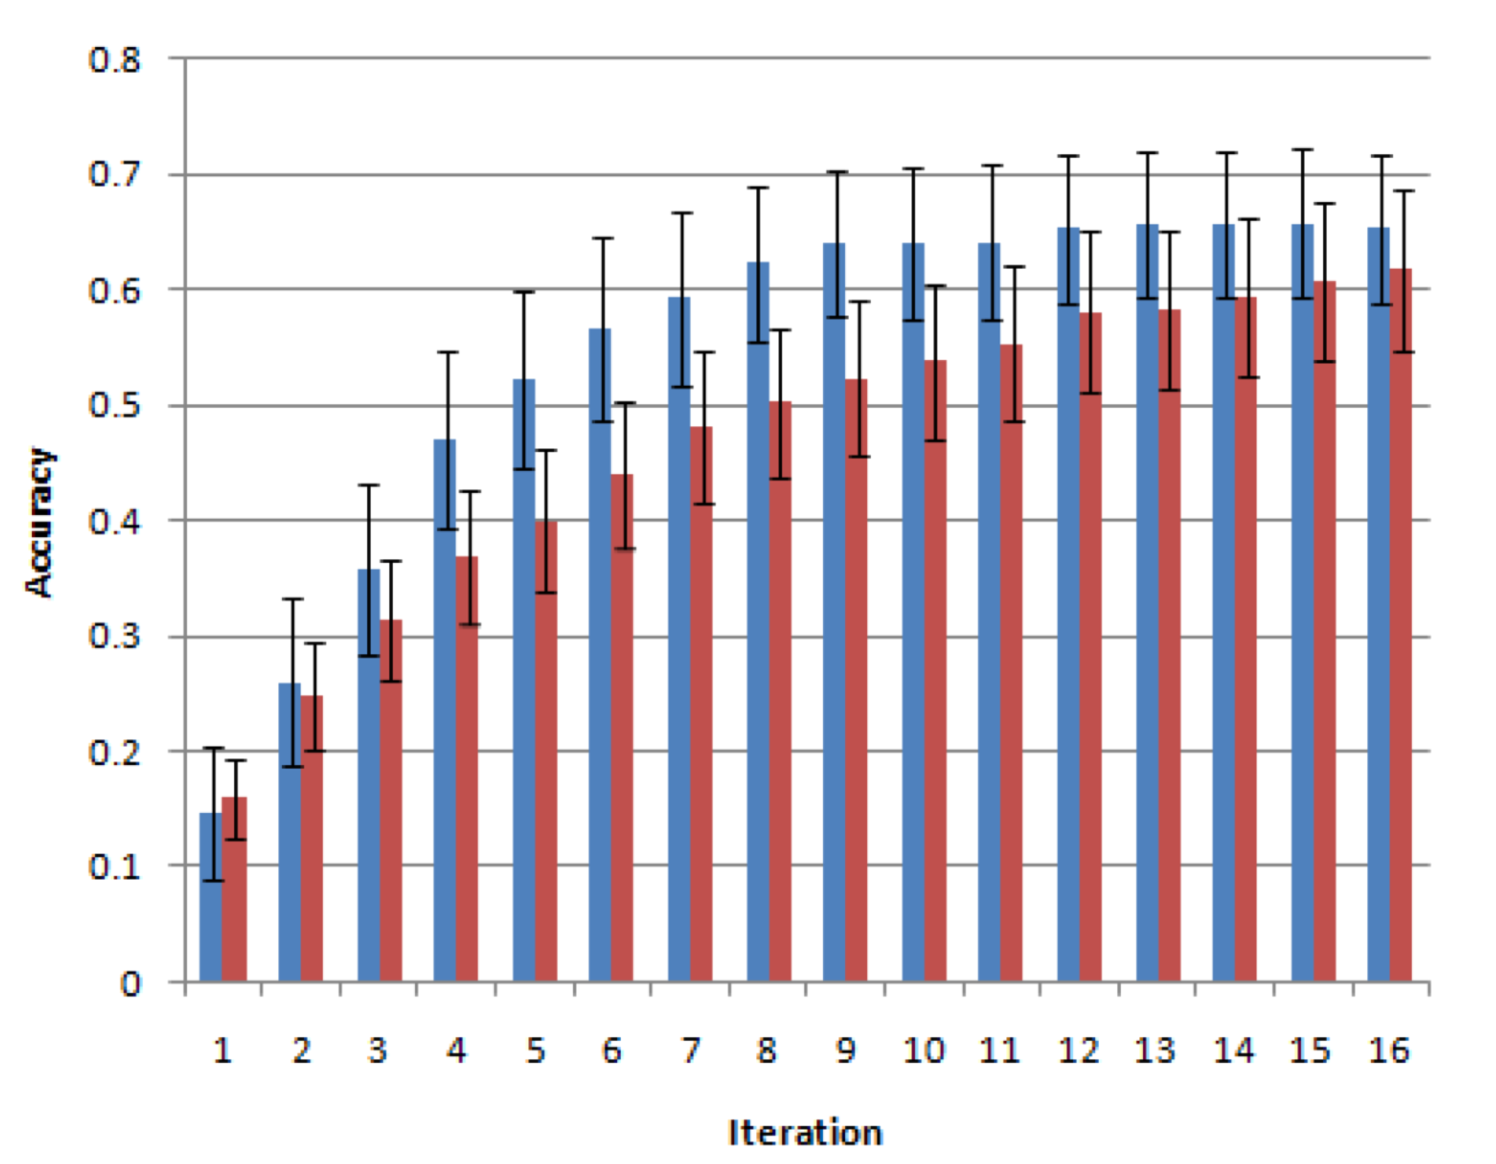
Accuracy after several iterations
Iterative
Parallel
Notes:
The overlap suggests that the processes may not be different, or that there were not enough samples in their experiment to see a statistically significant difference.

Slide 142
Sometimes poor initial guesses cause problems
8th iteration: “Please do ask *anything you need *me. Everything is going fine, there * * , show me then * * anything you desire.”
16th iteration: “Please do ask *about anything you need *me. Everything is going fine, there *were * , show me then *bring * anything you desire.”
Several of the workers doing the task in the parallel condition got it 100% correct
Notes:
One Turker left this comment. “It's distracting with the words filled in--it's hard to see anything else but the words already there, so I don't feel I can really give a good “guess” ”.

Slide 143
Discussion
What do these results tell us about iterative versus parallel processing in human computation?
Are the experiments well formulated?
Is James Surowiecki right?

Slide 144
Tradeoff between average and best
The brainstorming task showed tradeoff between increasing the average quality vs increasing the chance of finding the best
Showing previous work increased quality, but decreased variance

Slide 145
Leading people astray
The blurry text task showed that initially bad guesses can lead to poorer quality later
Suggests that a hybrid approach may be better: start multiple iterative jobs in parallel

Slide 146
Conclusions
Experimentally, iteration seems to increase the average quality of responses over parallel processing
However, brainstorming and transcription benefit from a variety of responses
Poor guesses in the transcription task can lead subsequent workers astray
Notes:
Statistically significant in writing and brainstorming.

Slide 147
Future Work

Slide 148
Recap: Model
 | dependently (iteratively) | independently (in parallel)
creation tasks
decision tasks
Notes:
Task type and how it is done

Slide 149
What factors affect Creation Tasks?
How much does the reward affect quality?
How much work is expected? Is it better to break the task down into smaller pieces?
Are examples shown? Is prior work shown?

Slide 150
What factors affect Decision Tasks?
Goal is to determine the best items in a set
What’s the best way to achieve this?
Absolute ratings?
Pair-wise comparisons?
Sorting multiple items in a single task?

Slide 151
New building blocks
What other building blocks exist?
What paradigms and metaphors should we use to think about human computation?

